Slide 1

Fablab Rwanda
Learn how to make almost anything

Slide 2

FABLAB
RWANDA
Fablab Rwanda is a non profit organisation operating since 2016. The organisation provides a space for it’s members to turn innovative ideas into products, from software to hardware to functional systems.
The space provides a platform for capacity building, knowledge sharing and the integration of hardware and software and multiple engineering and technology disciplines, quickly bringing Rwandan innovators into the era of a connected world, where the Internet of Things connects not just people but the devices that we use in our daily work.

Slide 3

Objectives
a. To Provide shared workspace and tools for schools, TVETs & individuals to work and develop ideas into products in a wide range of domains,
b. To develop Skills in technology education through events & workshops,
c. To facilitate translation of innovative concepts into marketable products,
d. To enhance number of professional design experts in Rwanda with word class hands on experience and access to tools.
e. To increase research and improve designs of African centric hardware tools

Slide 4
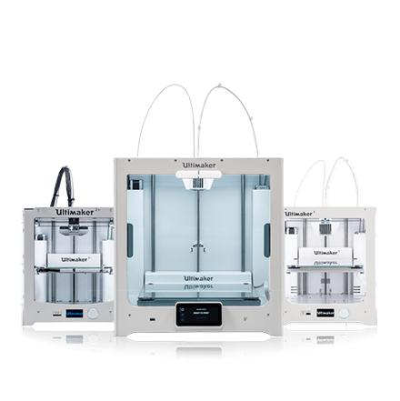
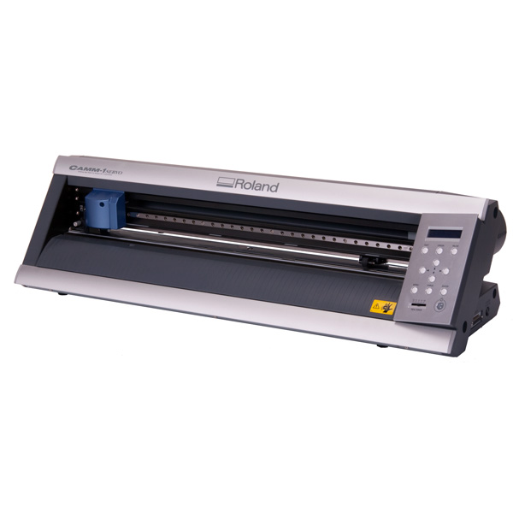
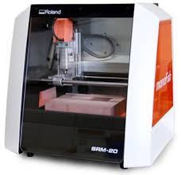
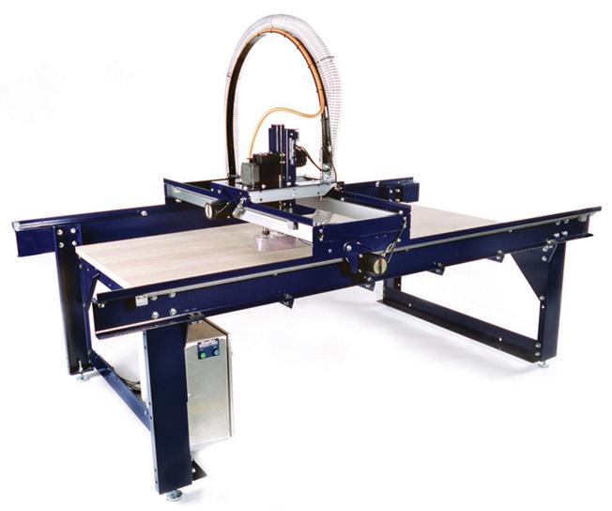
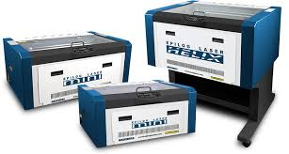

Prototyping Equipments.
The most distinctive feature of the lab are it’s tools. There are those machinery, you can’t just find while strolling in town on a sunday afternoon. They are complex equipments that were assembled in some of the world renowned industries such as the roland corporation that is found in japan. Not everyone can use the tools, it requires experts in different fields in order to operate the machines. Those experts be it designers or engineers are the ones in charge of prototyping and dealing with the public’s demands.

Slide 5
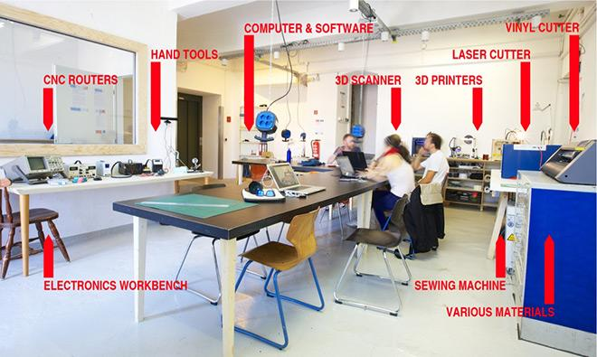

Slide 6
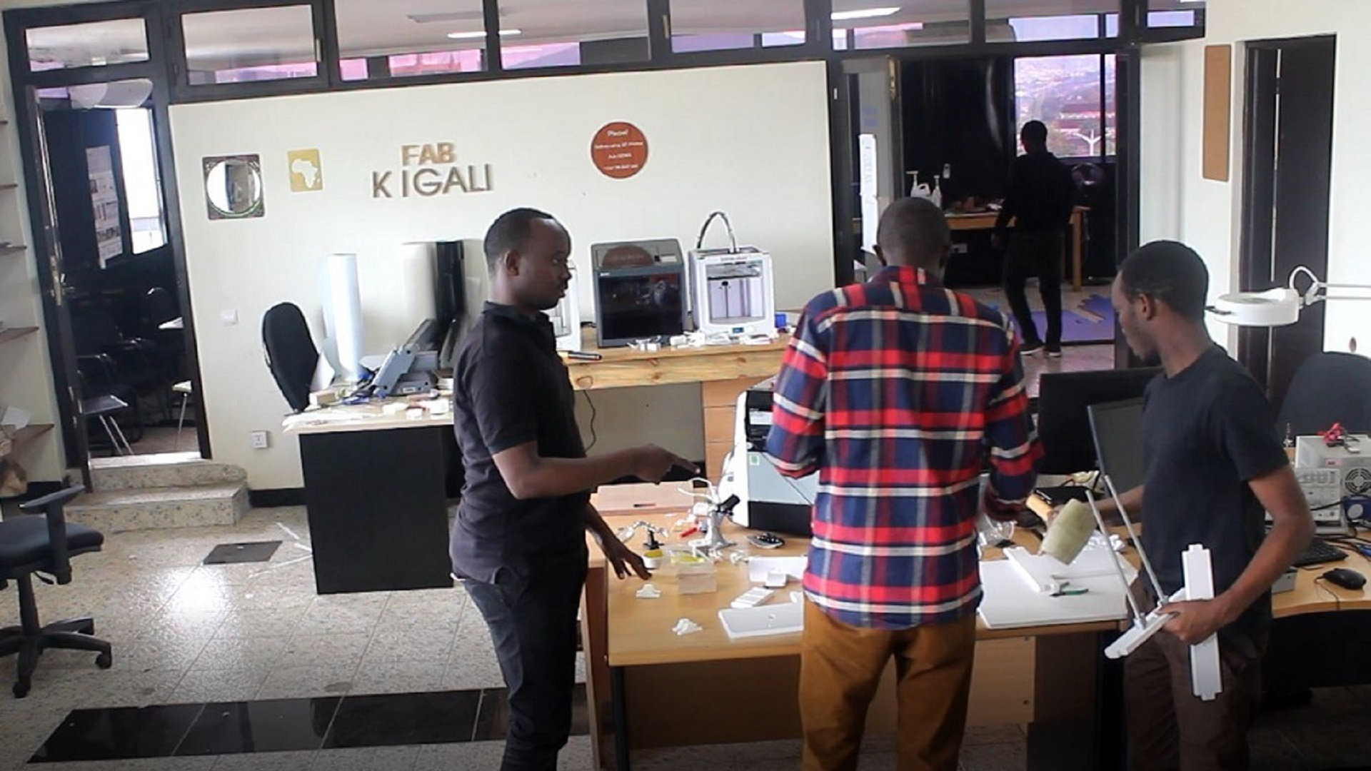
Fab Academy
Principles and application of digital fabrication
Another crucial part of Fablab Rwanda is the Fab Academy. Fab Academy is a fast hands on experience where students learn rapid prototyping by planning and executing a new project each week, resulting in a personal portfolio of technical accomplishments.
Fab academy also known as the academy of almost anything , runs in more than 70 Fab labs for more than 250 students per year in the largest company of the world .
Students work in local groups with peers, mentors and machines which are then connected globally by content sharing and video for interactive classes.

Slide 7
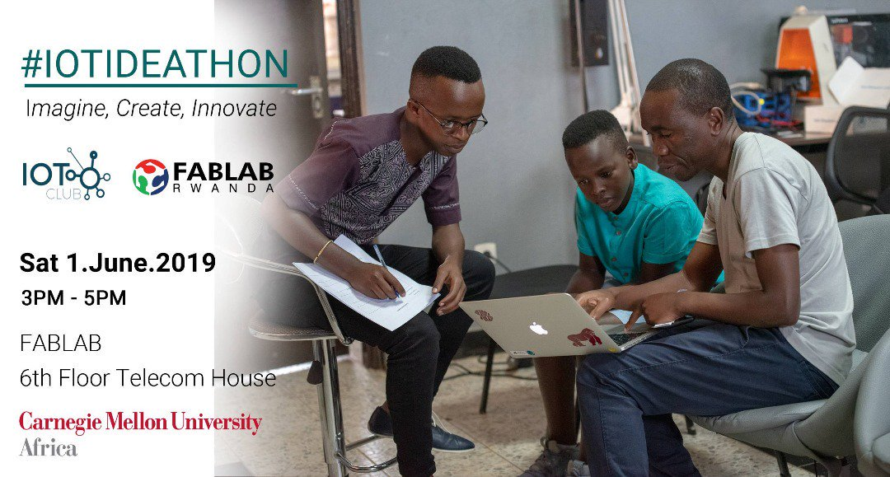
Programs
The lab shelters a great number of programs all with the aim to help it’s participants to turn their ideas into fruitful projects.
Some of those programs consist basically of teaching it’s participants how to operate with the complex tools found in the lab and the respective softwares that help run those given tools.
Other programs such as the IoT ideathon provide extras since they don’t only offer their participants with explicit trainings but also contribute to the development of

Slide 8
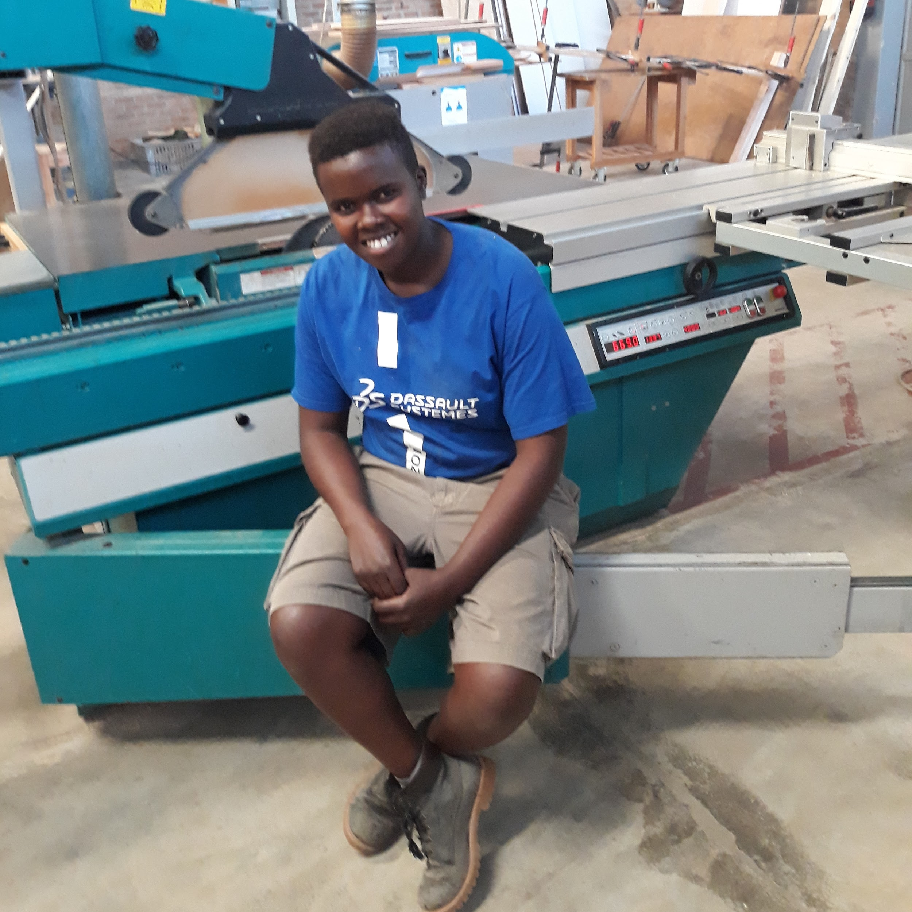
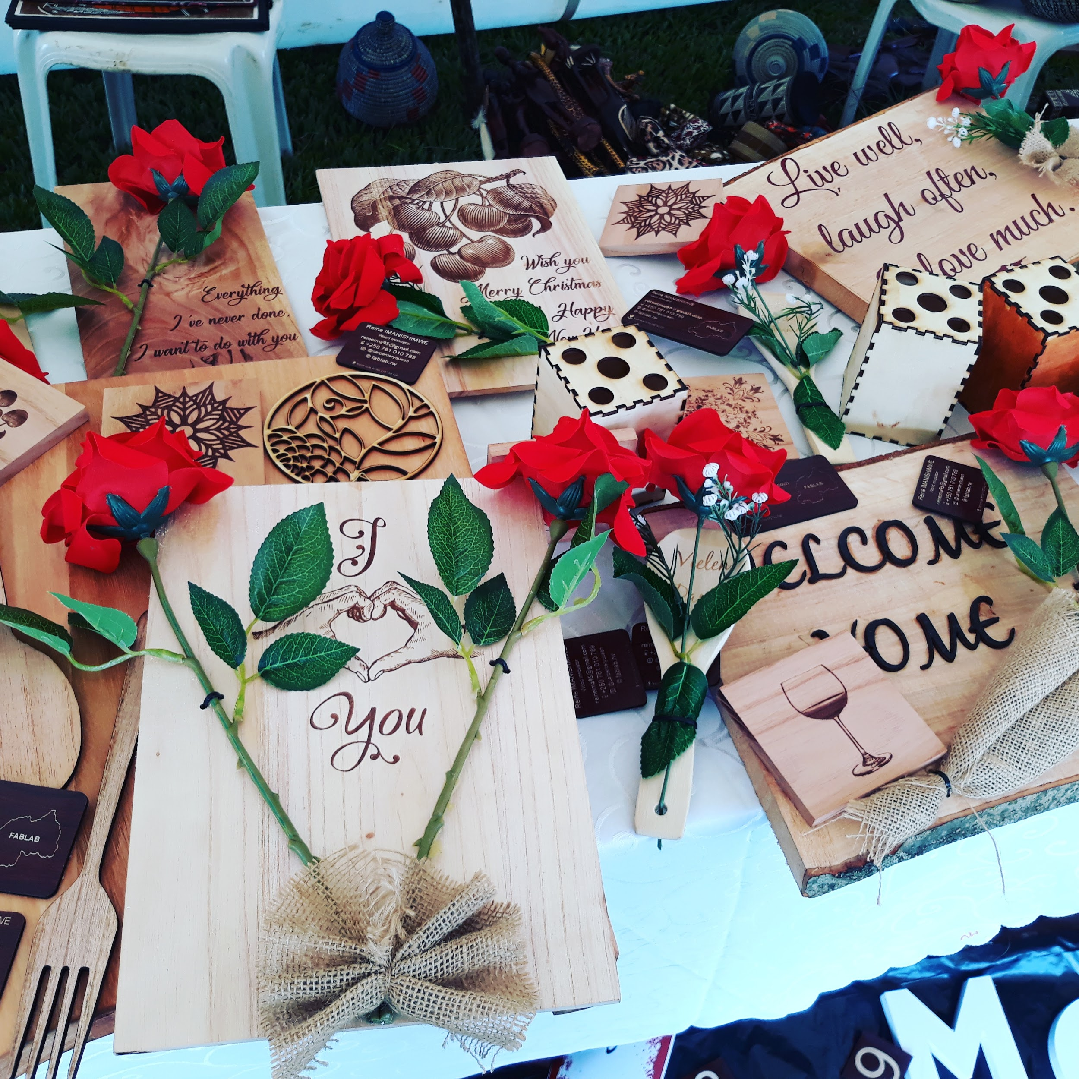
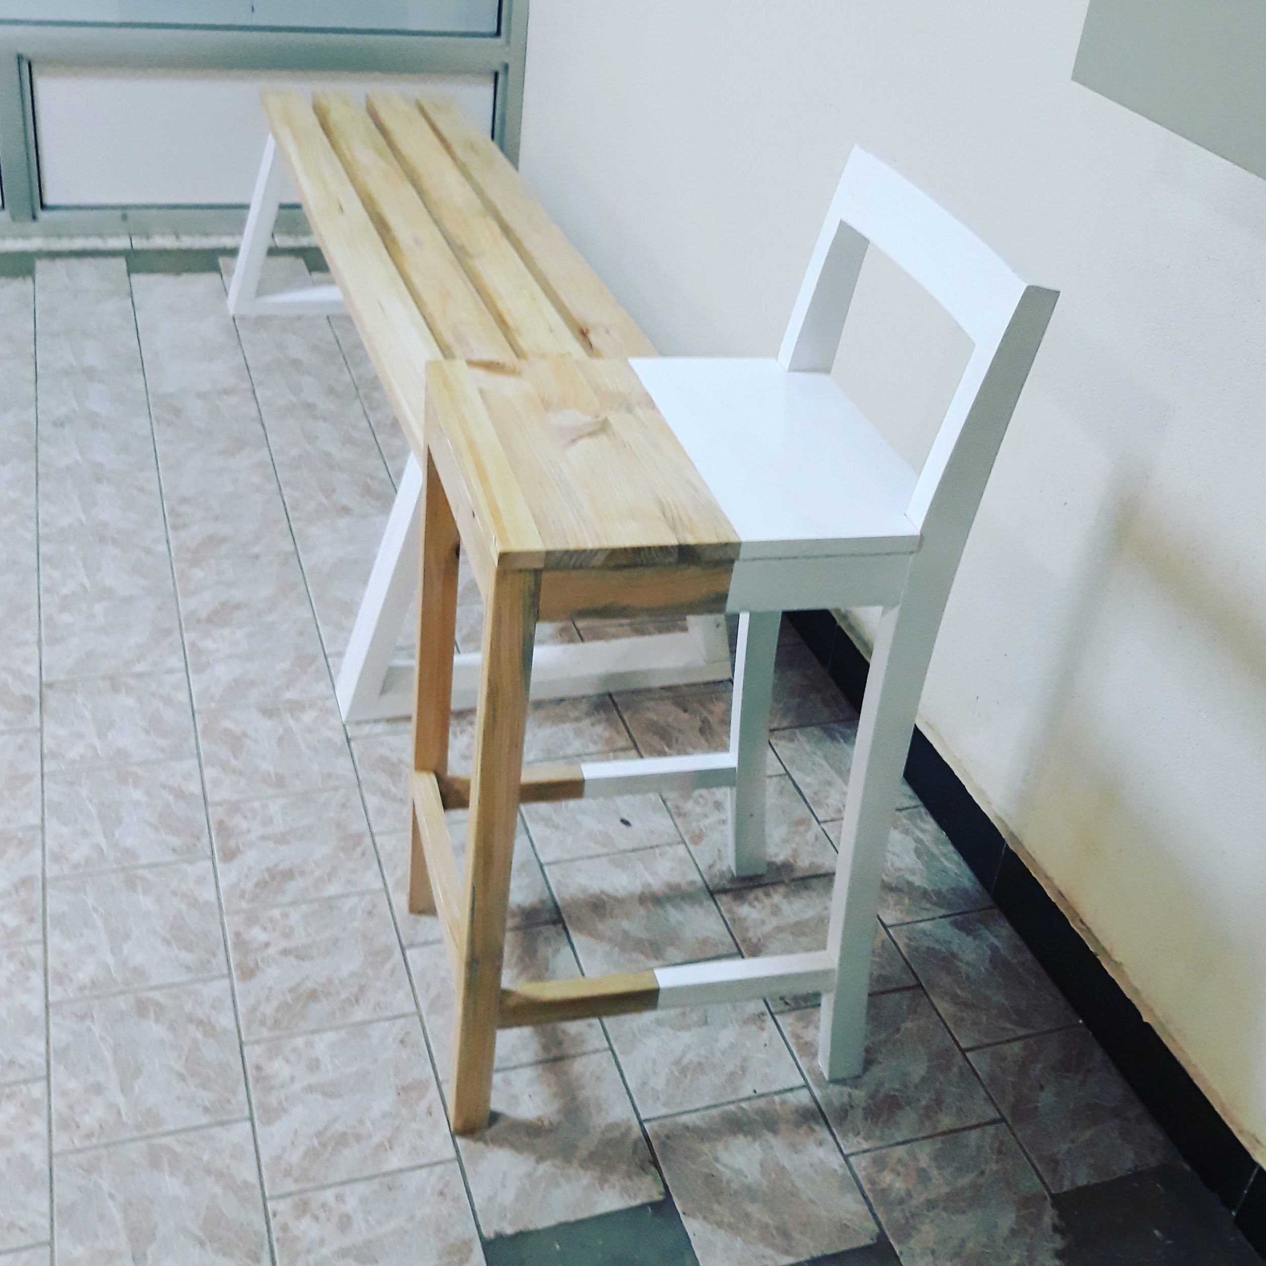
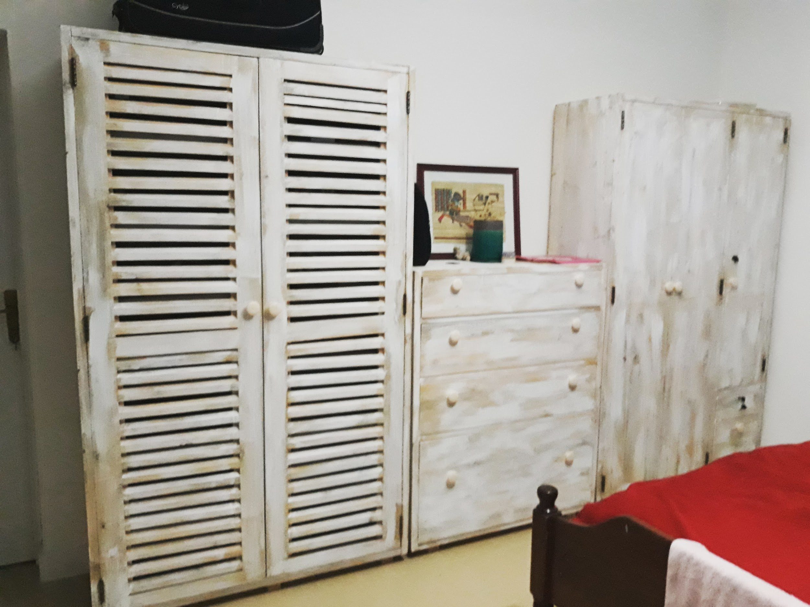
PROJECTS
Fablab rwanda in addition of helping innovators turn their ideas into marketable projects ,it also acts as an incubator for start up businesses. Imanishimwe Queen is the founder of the Queen Business limited company, which is specialized in the manufacture of wooden furnitures such as chairs, tables, bed, doors, etc. Queen said she joined Fablab to see what she could learn to add to her knowledge and expand her world through a collection of experiences she hoped to meet in the environment she was joining.
After almost three years working with Fablab, Queen expectations were met and even more than she imagined, she not only acquired new skills but she is thankful for that easy access to technology that greatly improved her work and that world wide connectivity, that allowed her to meet with different investors that were interested in her profession.

Slide 9
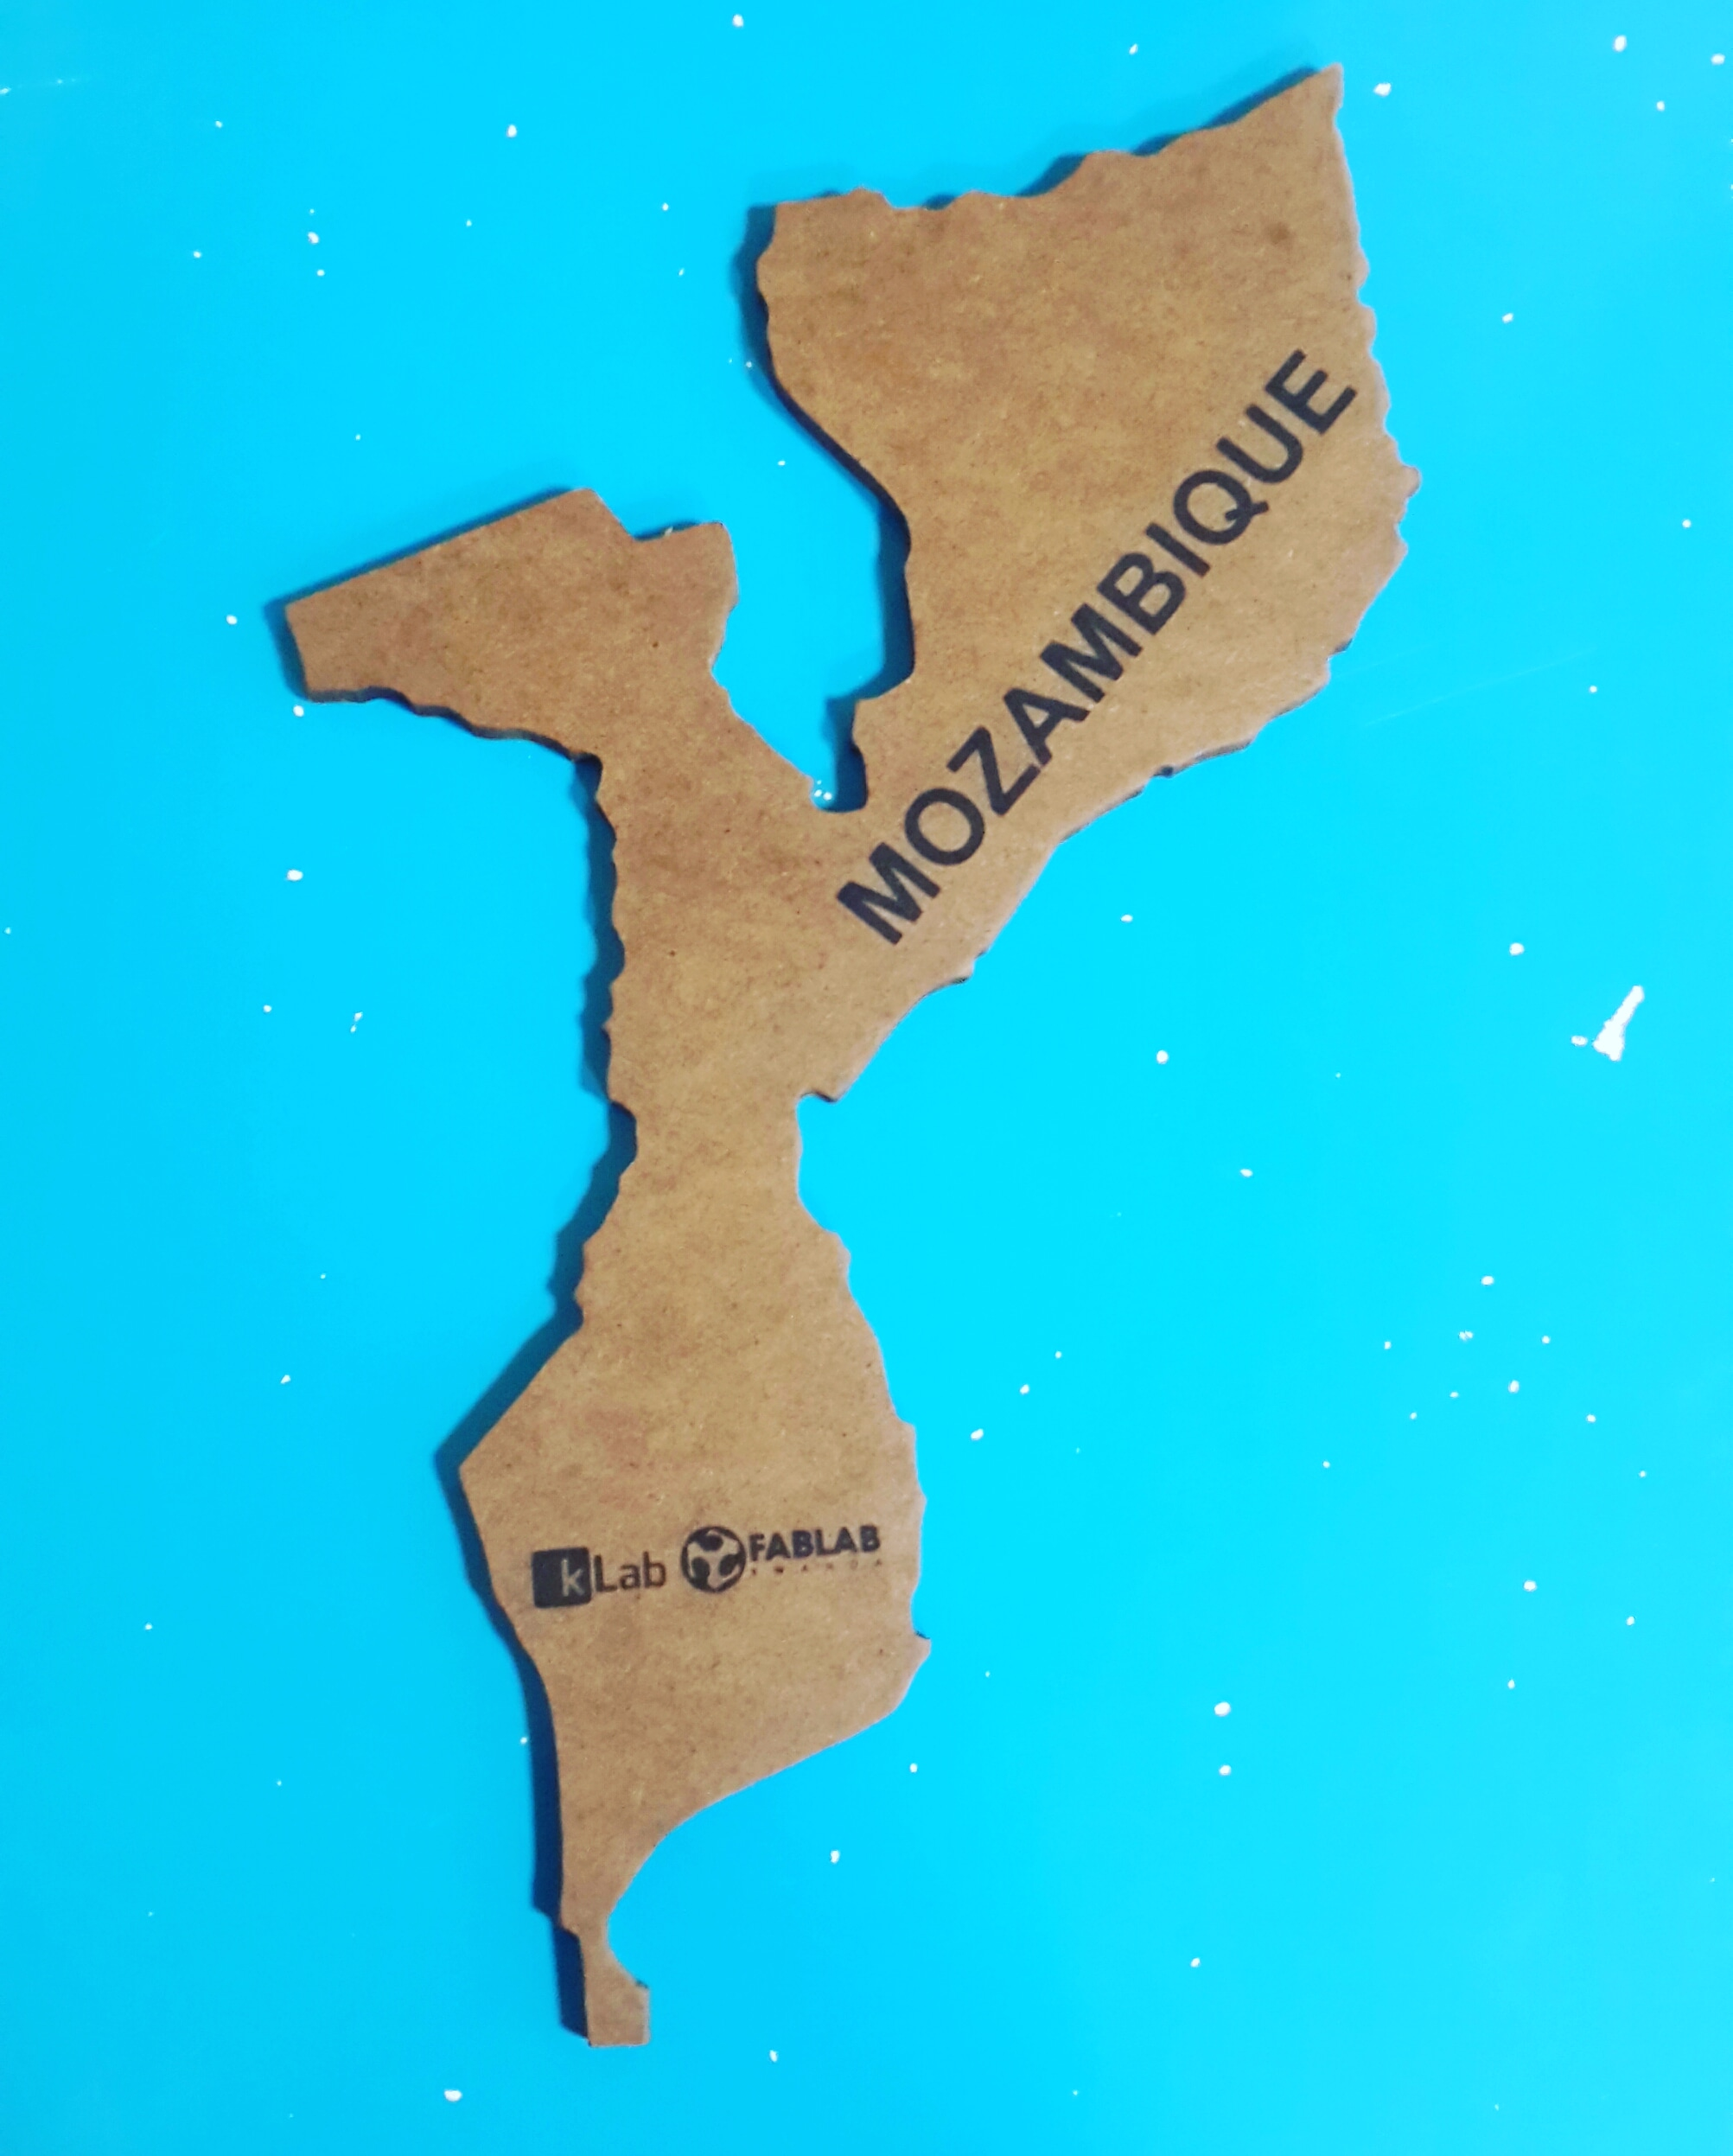
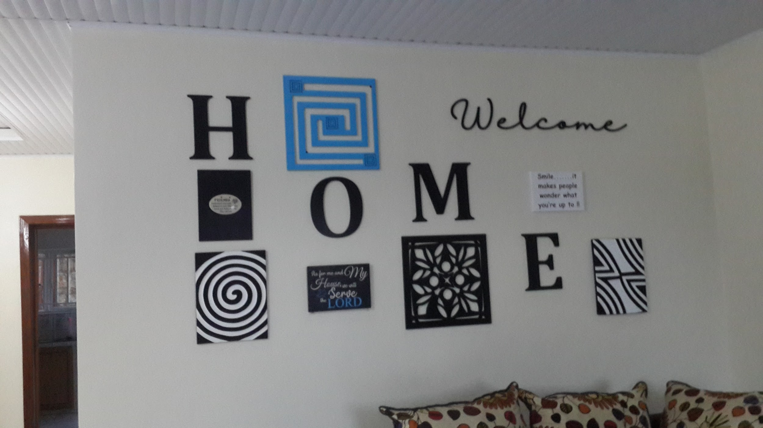
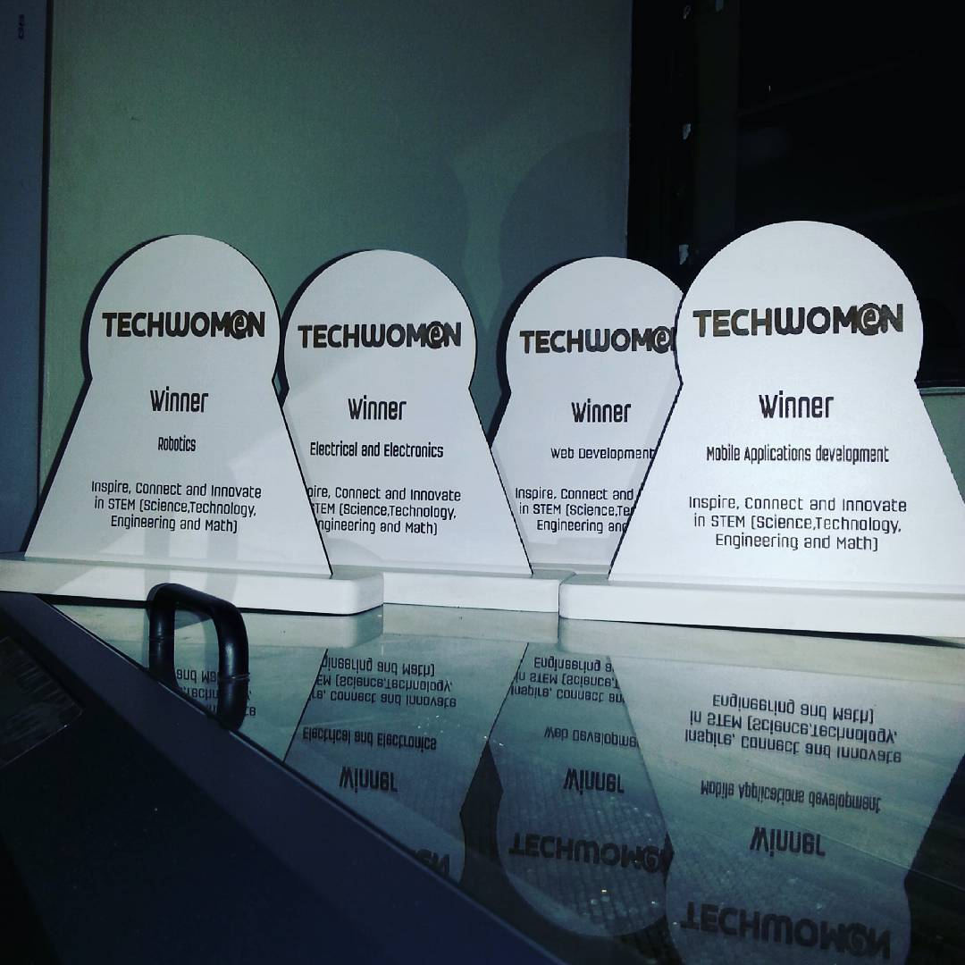
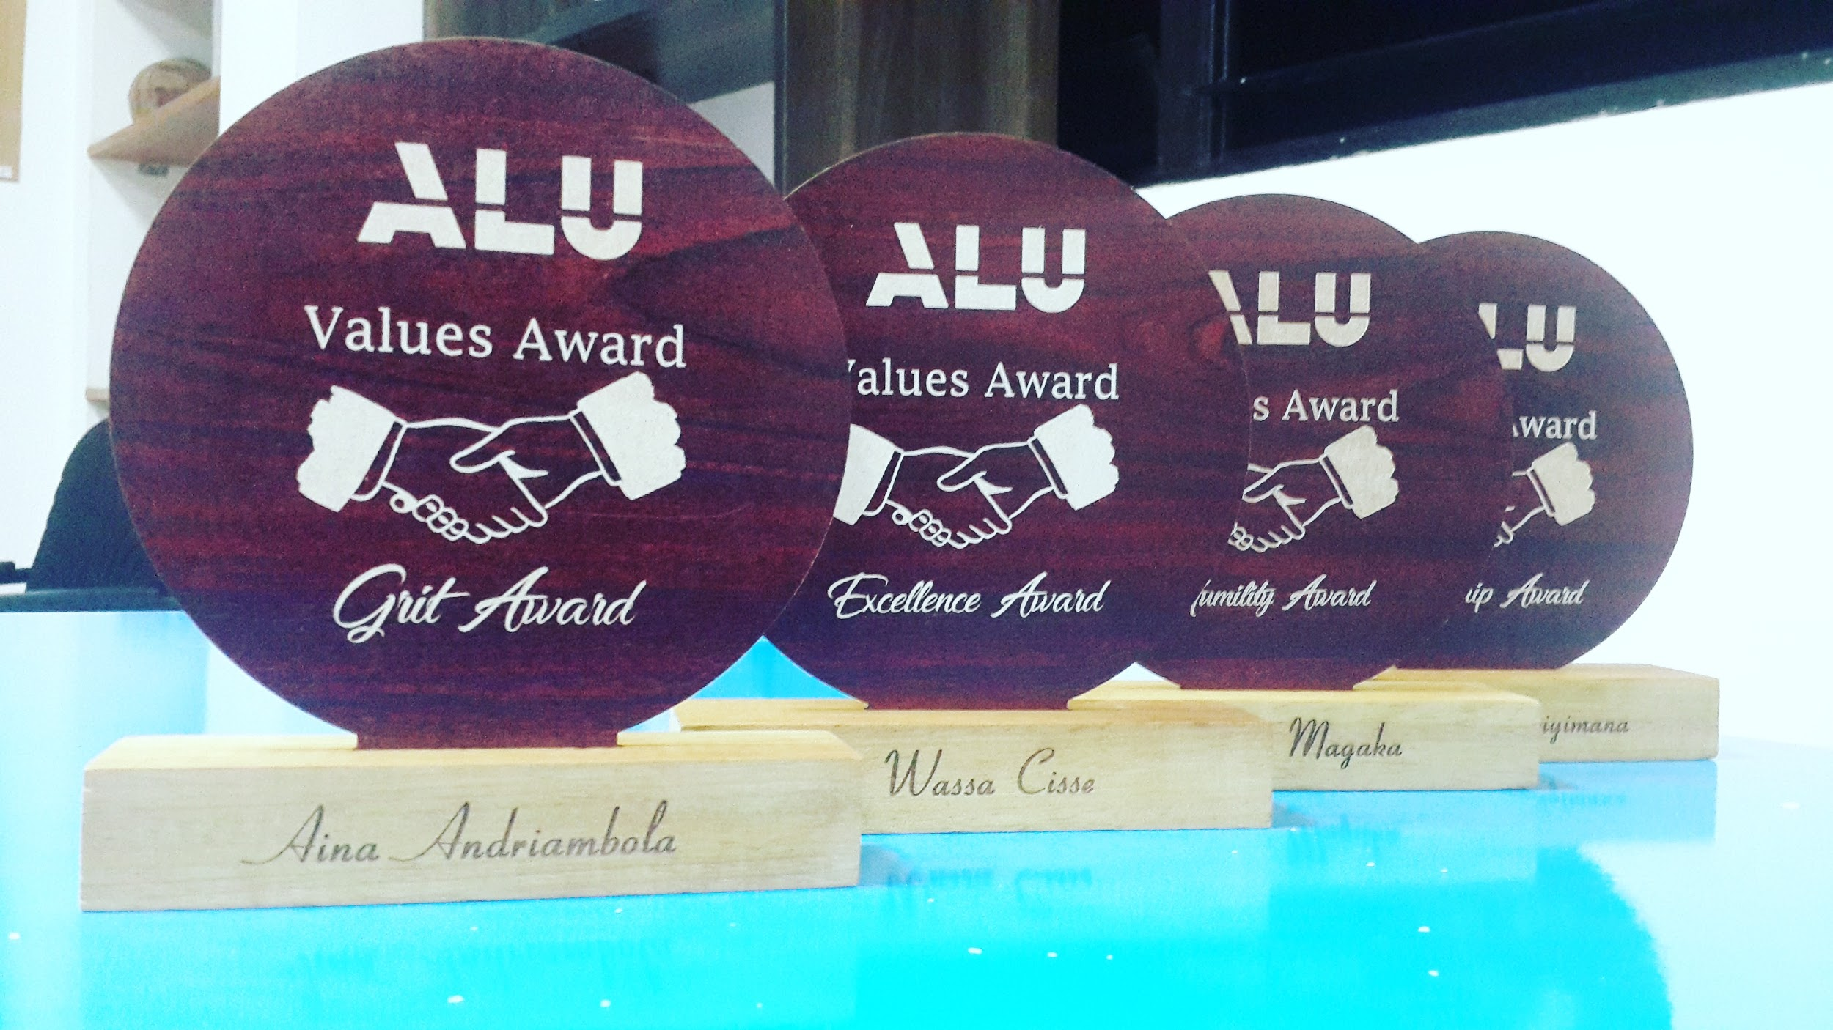

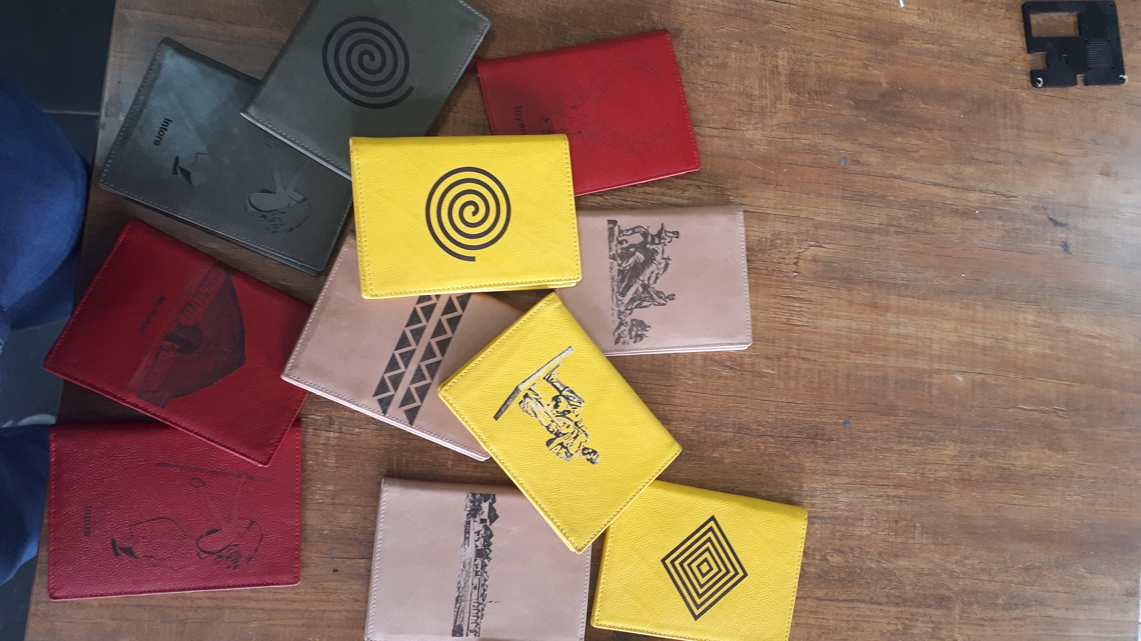



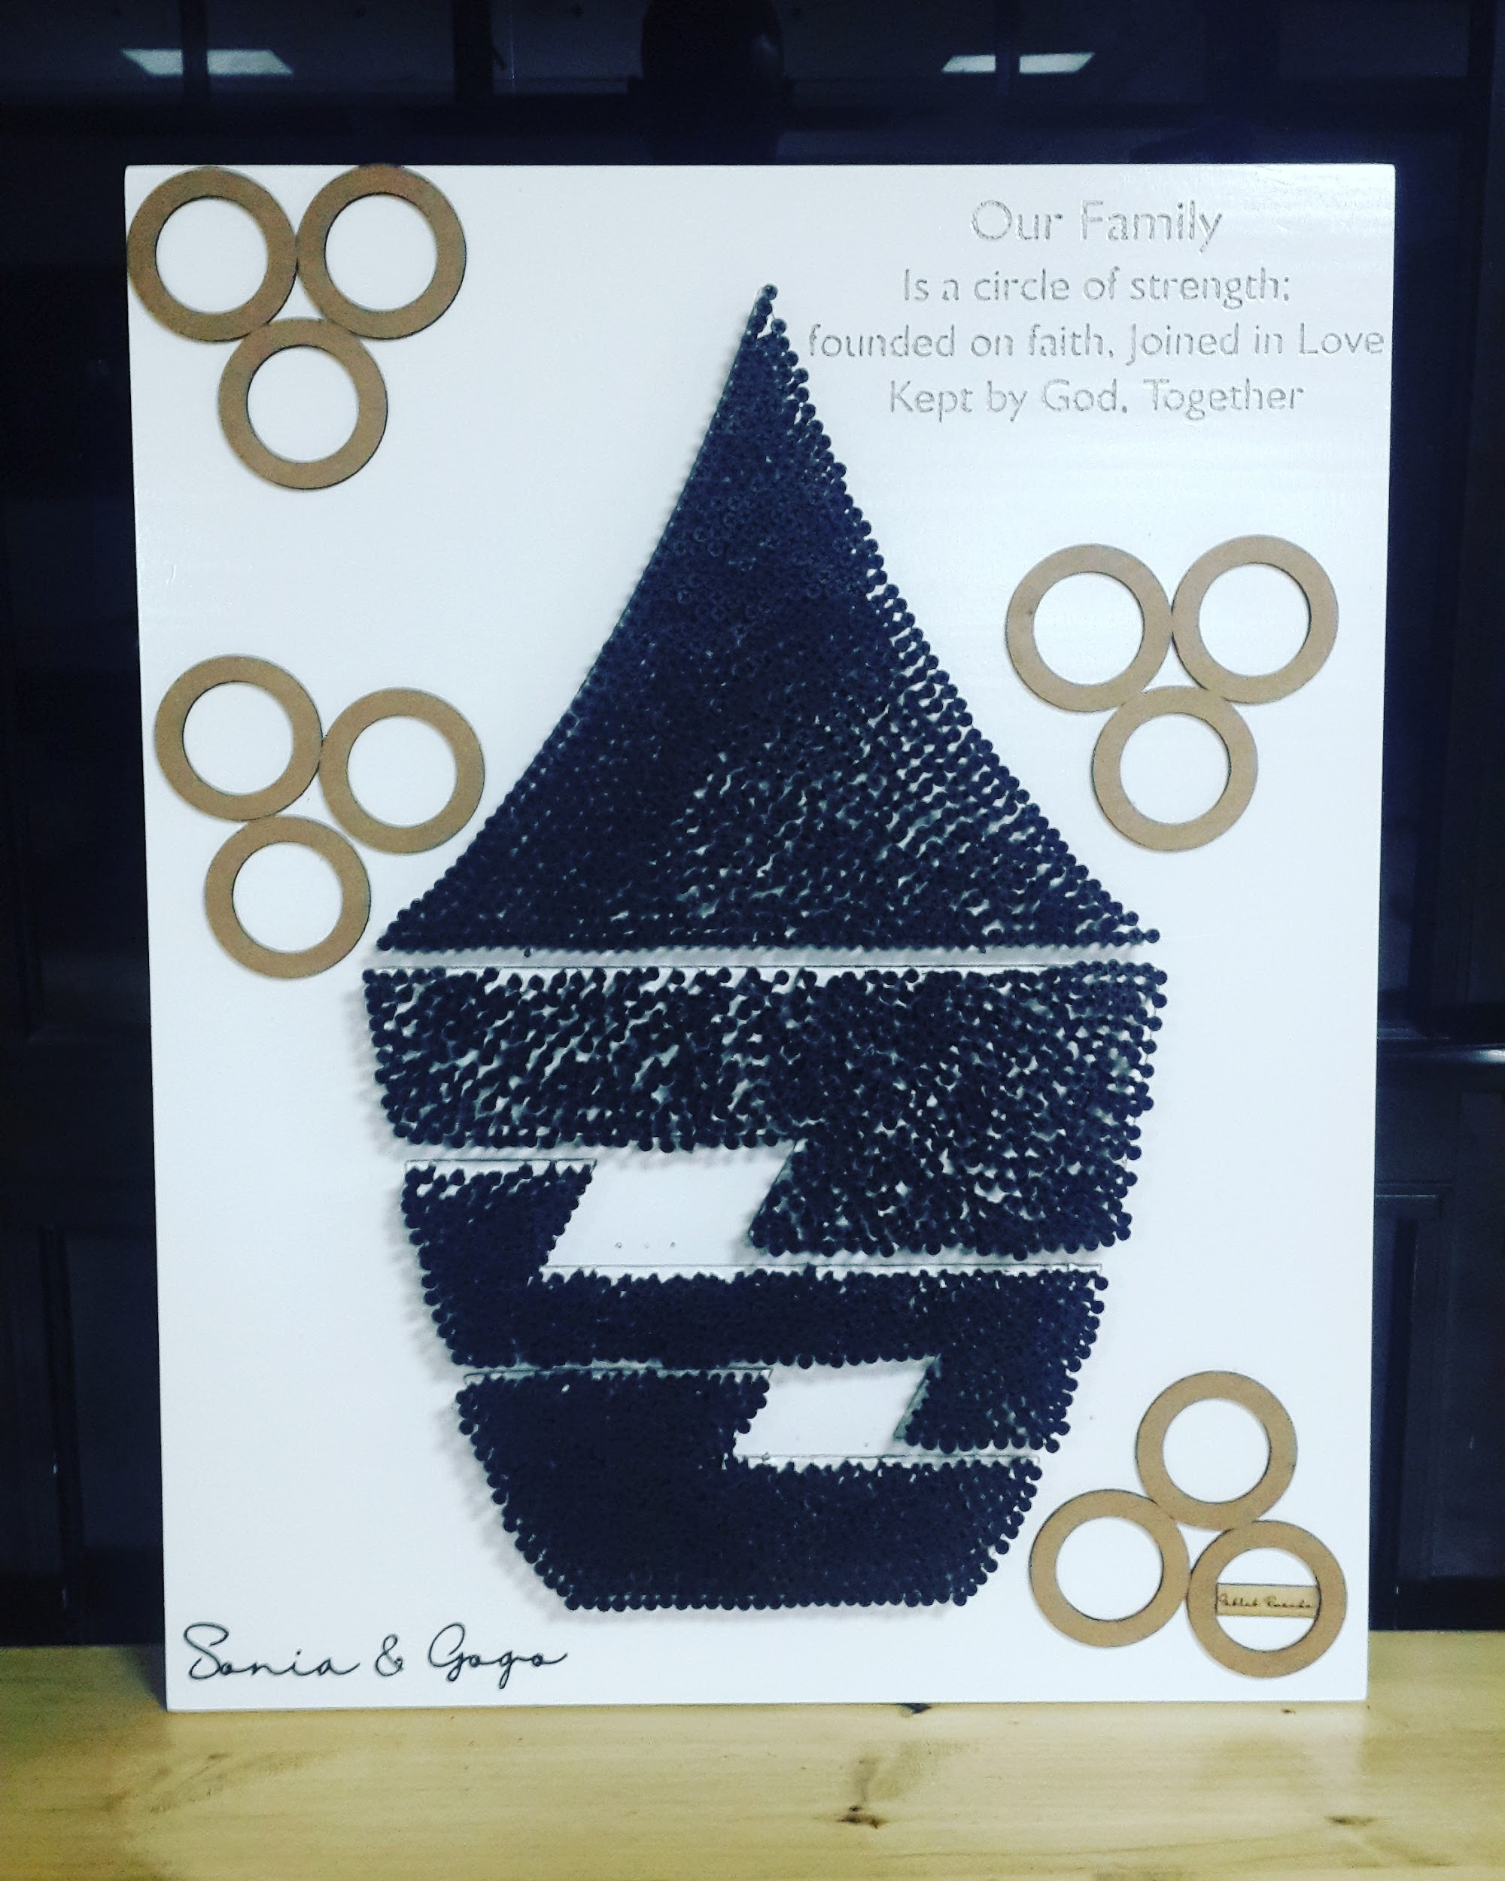
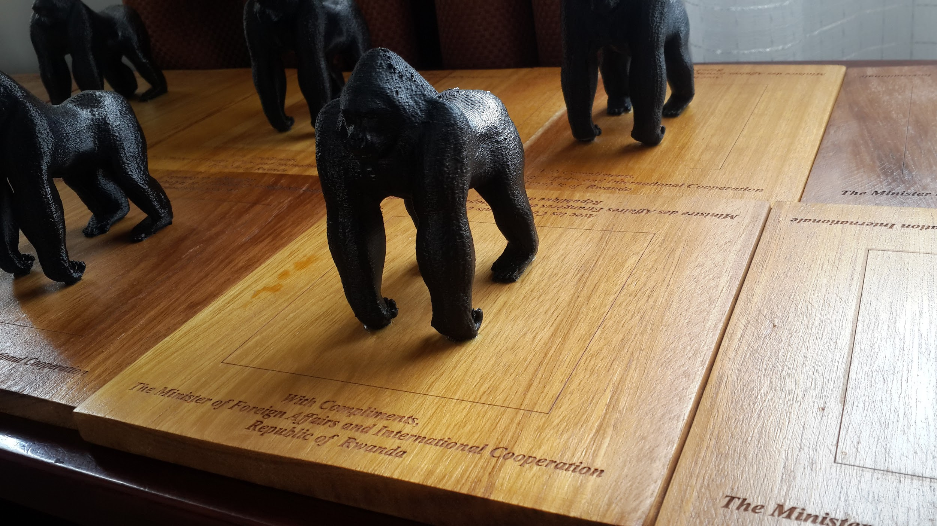
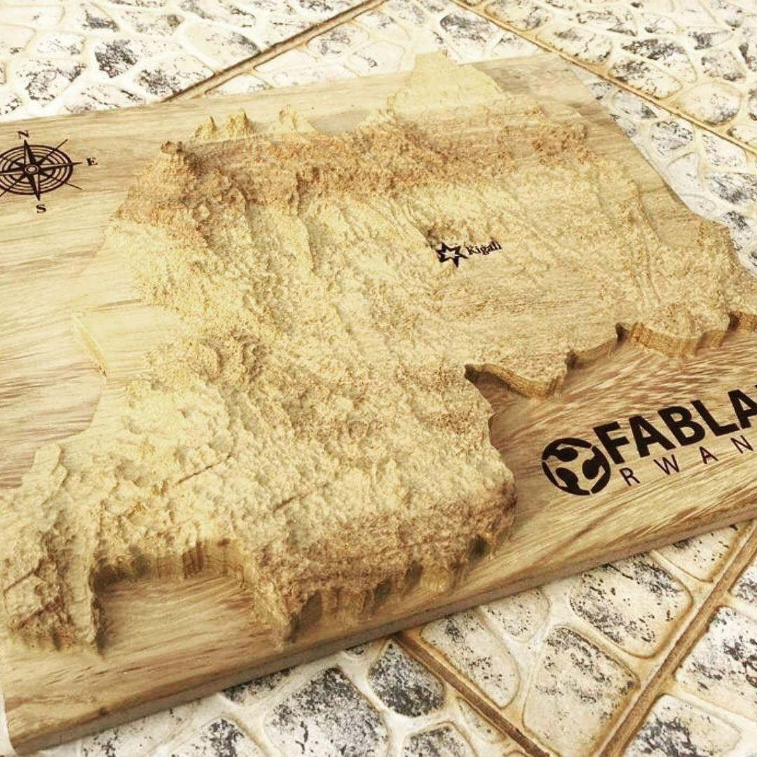
FABLAB RWANDA
Digital products

Slide 10




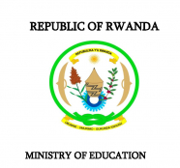




Partners

